Slide 1
Introducing to Digitized Currency (Crypto Currency)
Prepared by: Dorji Jamtsho
Dzongkhag Procurement Officer
BUMTHANG.

Slide 2
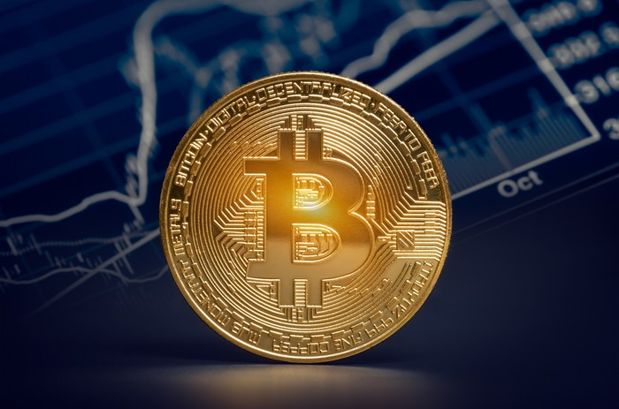
Crypto Currency

Slide 3
CONTENTS
What is Crypto currency?
Characteristics of Crypto currency
How crypto currency works?
What is Bitcoin?
Who created Bitcoin?
How does Bitcoin work?
How do you get Bitcoin?
Legality of Bitcoin
Challenges & Issues of Crypto currencies in Bhutan
Price Analysis of Crypto currency

Slide 4
What is Crypto currency?
Crypto currency is a medium of exchange, created and stored electronically in the blockchain, using encryption techniques to control the creation of monitory units and to verify the transfer of funds. Eg. Bitcoin, Etherium, Litecoin, Ripple, etc.
Bitcoin is best known example.
Notes:
Medium of exchange stored electronically in the block chain using encryption techniques.
Encryption techniques to control creation of monitory units and verify while transfer of funds.

Slide 5
Characteristics of Crypto currency
No intrinsic value-not redeemable for another commodity like gold.
No physical form-through network
Not determined by the central bank/decentralized
easy to handle
Transaction costs are negligible
payments are 100% transparent
Notes:
Essential value
Not exchangeable

Slide 6
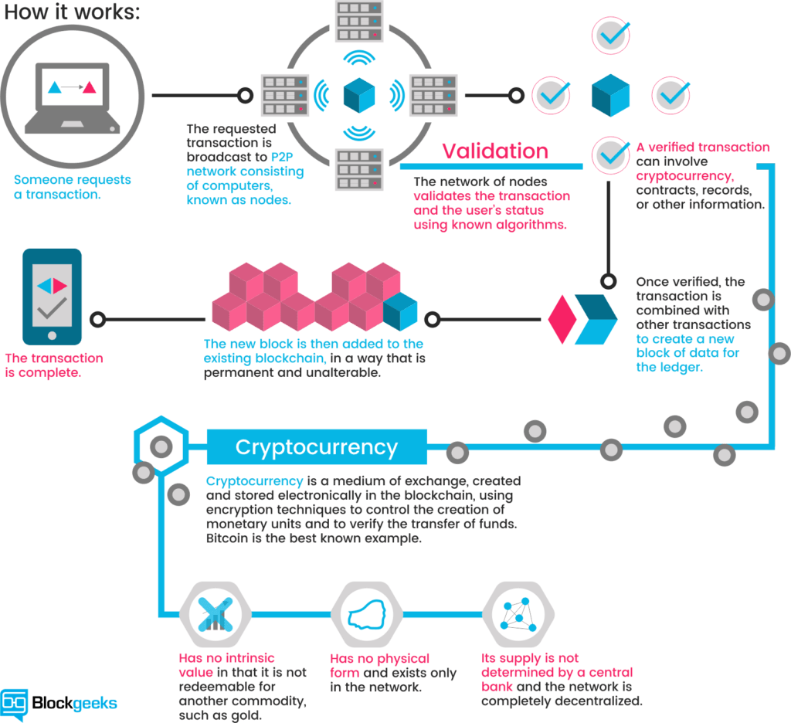
How Crypto currency works?
Notes:
Someone request a transaction > requested transaction is broadcast P2P using the network of nodes > Network of nodes validates the transaction known as algorithms.
Verified the record stored > verified transaction combines with other transaction to create new block of date for the ledger
New block than added to the existing blockchain which can be permanent > Transaction completes.

Slide 7
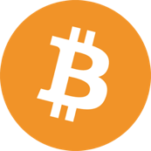
What is Bitcoin?
Decentralized digital currency
Like virtual Cash or gold
Transferred person-to-person
No bank or government prerequisites or control
BTC,
Crypto-currencies around since 1980’s
Divisible to .00000001 (USD=.01)

Slide 8
Who created Bitcoin?
Satoshi Nakamota
First Bitcoin issued in January 2009
- Limited to 21 million bitcoins
X amount of bitcoins are released every ~ 10 minutes
Until 2140

Slide 9
How does Bitcoin work?
Money - deposit into a bank account
Bitcoin – stored in public ledger
Sending / Receiving BTC easy as sending an email
Coins are stored in “Wallet”
Local hard drive
Paper
Hosted online
Two parts of a Bitcoin “accounts”
Public Key – account number/ address ~ 27- 34 alphanumeric characters
Example:123Baxjkslie1Ami3niws9Wsexc
2. Private Key – password to access bitcoins in the accounts

Slide 10
How do you get Bitcoin?
Three ways to acquire Bitcoins:
Buy (from a person or exchange)
Barter (sell product or service)
Mine (run software to find bitcoins)

Slide 11
Legality of Bitcoin
Japan – Bitcoin & Cryptocurrency can be used as legally accepted means of payment, but is not legal tender.
India- Bitcoin is legal and taxed.
USA- Bitcoin is legal and taxed as capital gains ( Property Asset)
Bitcoin is NOT “Legal Tender” in any country but is legal to own and use in most.
Illegal Countries includes: Algeria, Bolivia, Ecuador, Bangladesh, Nepal, Macedonia.

Slide 12
Challenges & Issue of Crypto currencies in Bhutan
RMA intervention
Lack of System support
Lack of awareness
Less reliable in digitization

Slide 13
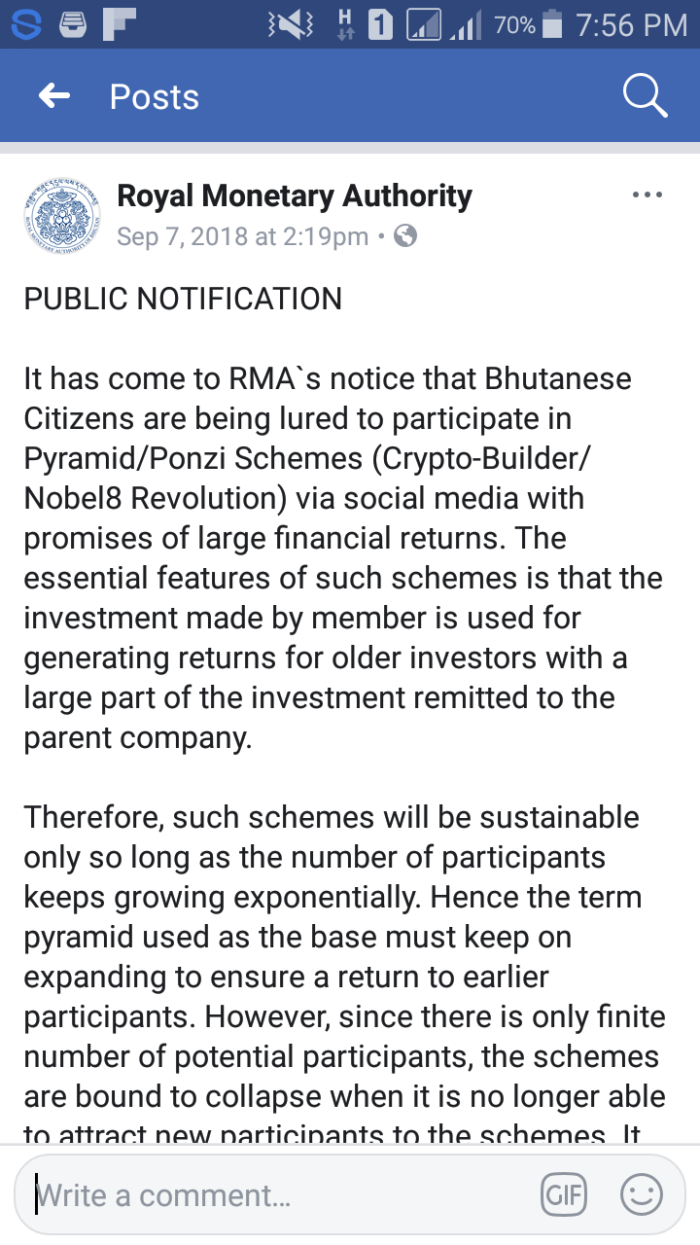
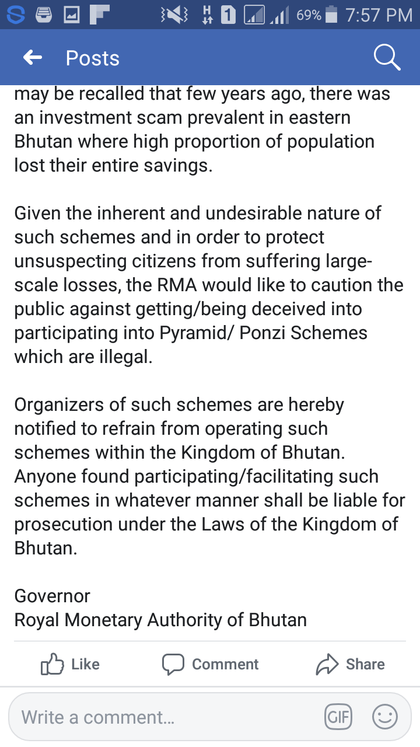

Slide 14
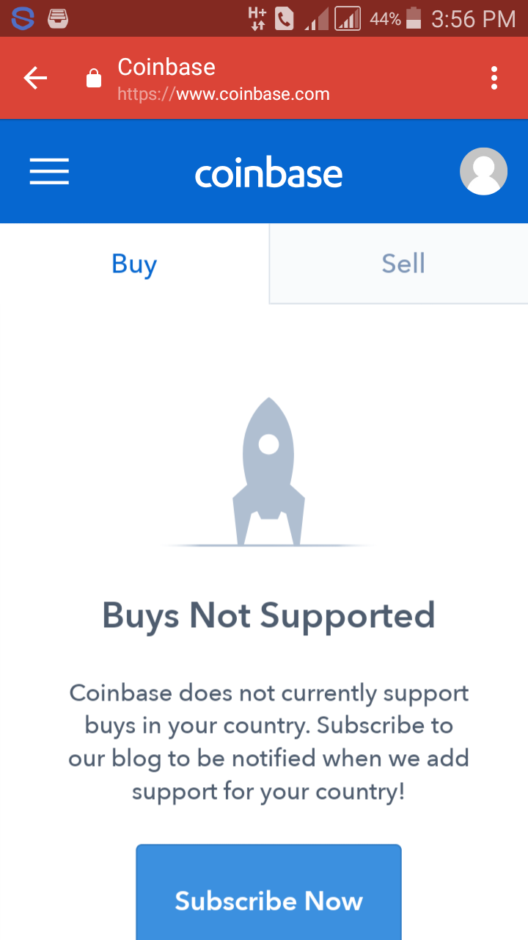

Slide 15
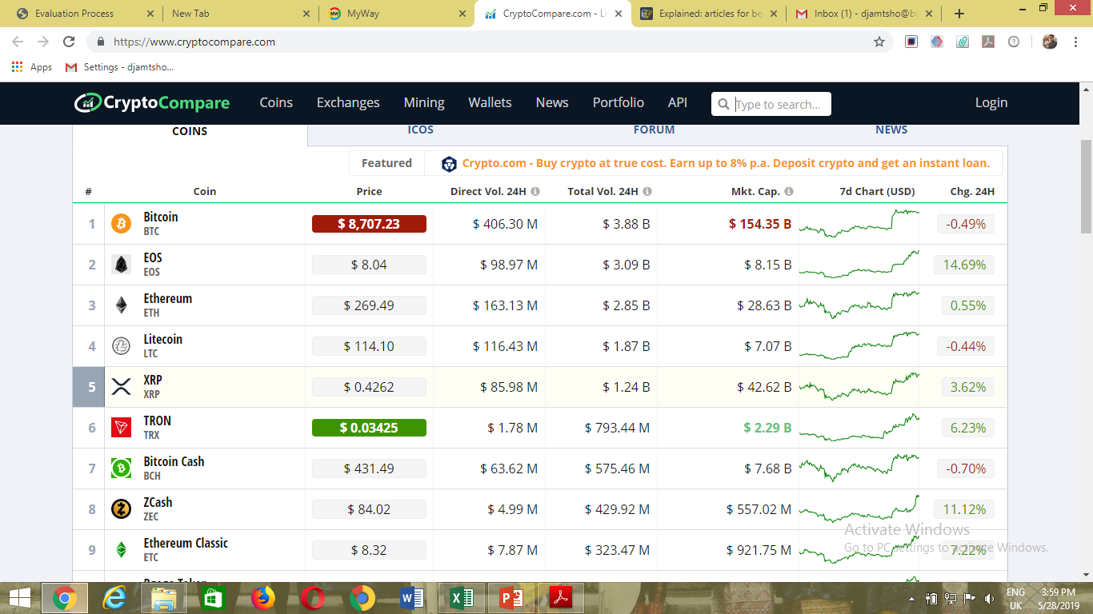
Price Analysis of Crypto currency

Slide 16
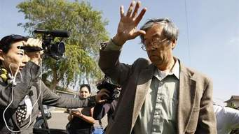
“A satisfied life is better than a successful life”

Slide 17
THANKS

